Slide 1
Veterans Incarcerated in NC
Particularly Those Preparing to Return to Our Communities

Slide 2
Background
In 2000, the U.S. Department of Justice estimated that 12% of those incarcerated in jails and prisons were veterans
80% of those veterans were eligible for VA services.
Without necessary intervention, this population is at high risk for medical and mental health problems as well as criminal recidivism.

Slide 3
The Case for Early Intervention
“Policymakers in U.S. corrections and government have raised concerns about the societal and institutional costs of a criminal justice system that does not address re-entry.”
“The re-entry movement has been fueled in part by a renewed hopefulness regarding criminal rehabilitation”
(Campbell, 2005)
(Sherman et al., 1997;Loosel, 1995).

Slide 4
Health Issues
81% substance abuse
12% homelessness
19% mental health
5 times > general population for AIDS *
9 times > general population for hepatitis *
4 times > general population for tuberculosis *
(2000 Bureau of Justice Statistics)
(National Commission on Correctional Health Care Report *)

Slide 5
Benefits of Early Intervention
Veterans are able to preemptively plan for:
Medical Care
Mental Health Treatment
Substance Abuse Treatment
Vocational Rehabilitation
Transitional Housing
Social Services

Slide 6
Benefits of Early Intervention
Securing needed services upon release will likely contribute to:
Decrease in criminal recidivism
Successful community adjustment
Self Sufficiency
Prevention of Homelessness
Increased quality of life
Family reunification

Slide 7
HCRV – Goal
Promote successful community integration
Conduct outreach while incarcerated
Engage in treatment and rehabilitation to:
Prevent homelessness
Readjust to community life
Desist from commission of new crimes or parole or probation violations

Slide 8
Council of State Governments Justice Center. Justice Reinvestment in NC, 2011

Slide 9
2009 Release By County
Council of State Governments Justice Center. Justice Reinvestment in NC. 2011.

Slide 10
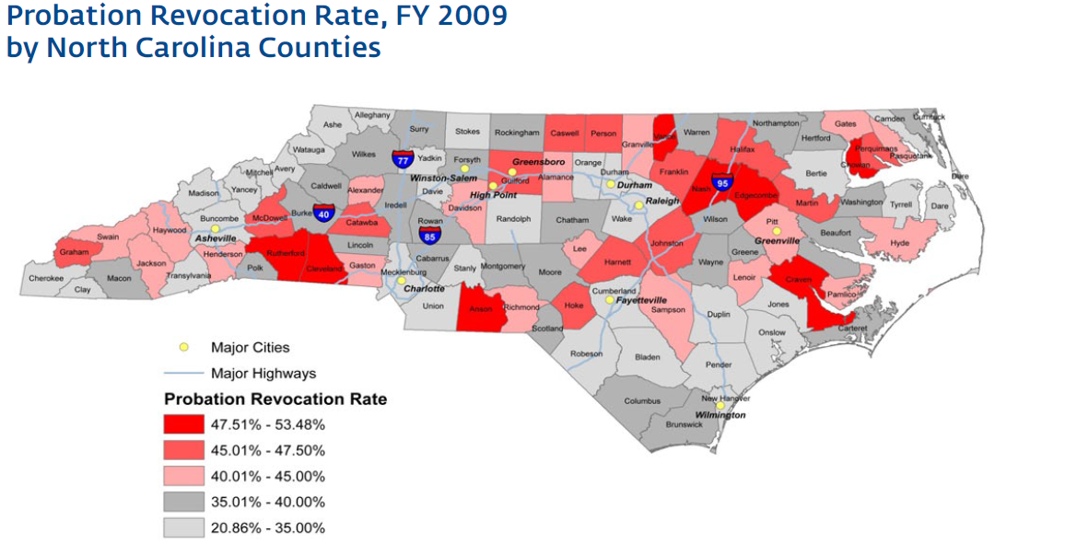
Council of State Governments Justice Center. Justice Reinvestment in NC, 2011

Slide 11
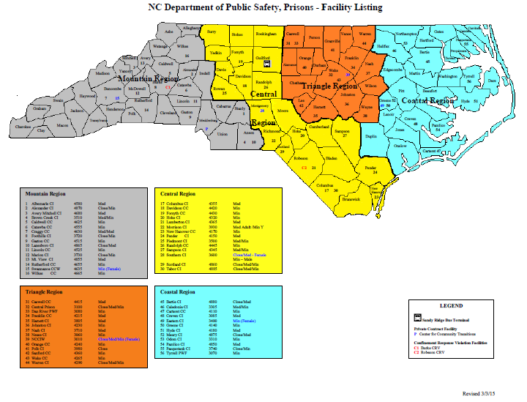
BOP Federal Complex in Butner
BOP Federal Contract Facility Rivers in Winton

Slide 12
Veterans incarcerated in NCDPS
On any given day between 2,000 and 2,500
Numbers from VRSS often miss those who served during/prior to Vietnam
Self-report from NCDPS numbers are higher
1,920 Veterans in NC state prisons (VRSS)
414 with release dates in 2015
233 with release dates in 2016
146 with release dates in 2017

Slide 15
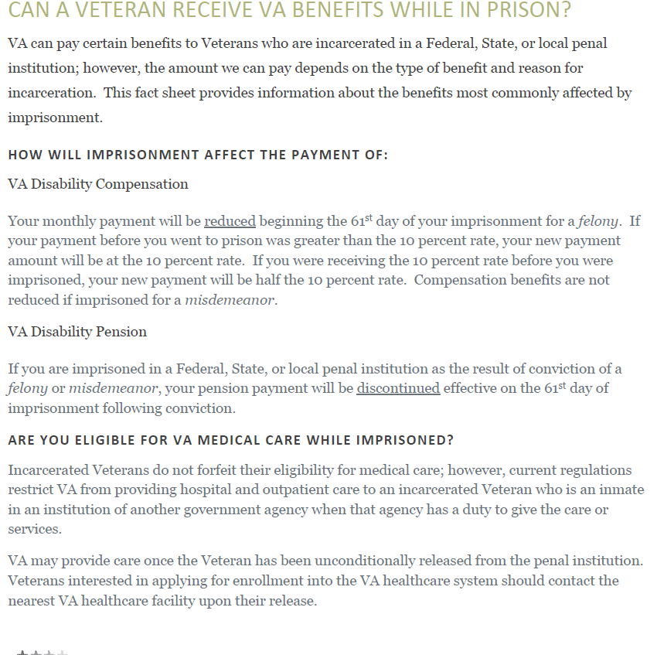

Slide 16
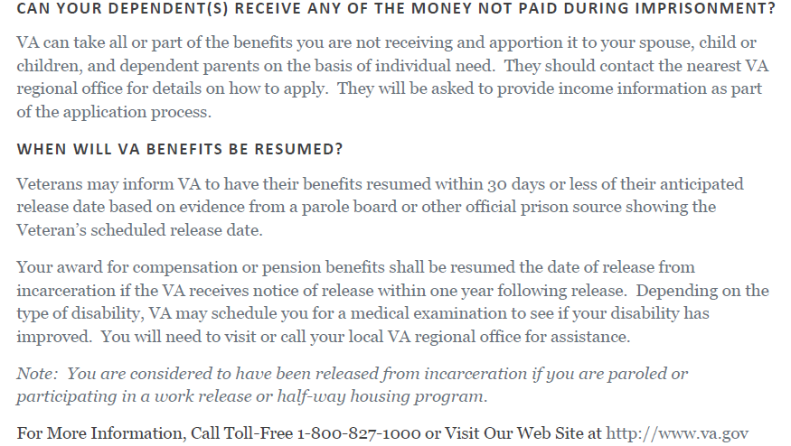

Slide 17
Filing Claims While Incarcerated
Income is a protective factor against recidivism and homelessness
Need the assistance of VSOs
VA has a duty to assist
Difficulties with C&P exams while in institutions

Slide 18
http://www.va.gov/homeless/vjo.asp

Slide 19
Veteran Justice Outreach Specialists (presentencing)
Fayetteville VA Medical Center
230 Ramsey Street
Fayetteville, NC 28301
Curtis Murrow, MSW (Harnett VTC)
800.771.6106 x 7225
Cristen Koslik, LCSW (Cumberland VTC) 800.771.6106 x 5742
Charles George VA Medical Center
1100 Tunnel Road
Asheville, NC 28805
Katie Stewart, MSW, LCSW (Buncombe VTC) 800.932.6408 x 1195
W.G. Bill Hefner VA Medical Center
1601 Brenner Ave
Salisbury, NC 28144
Carolyn Cardwell, LCSW
800.469.8262 x 4129 (south)
Kate Sullivan, LCSW
704.762.5064 (north)
Durham VA Medical Center
508 Fulton St
Durham, NC 27705
Jeremy Brogden, LCSW
888.878.6890 x 5186

Slide 20
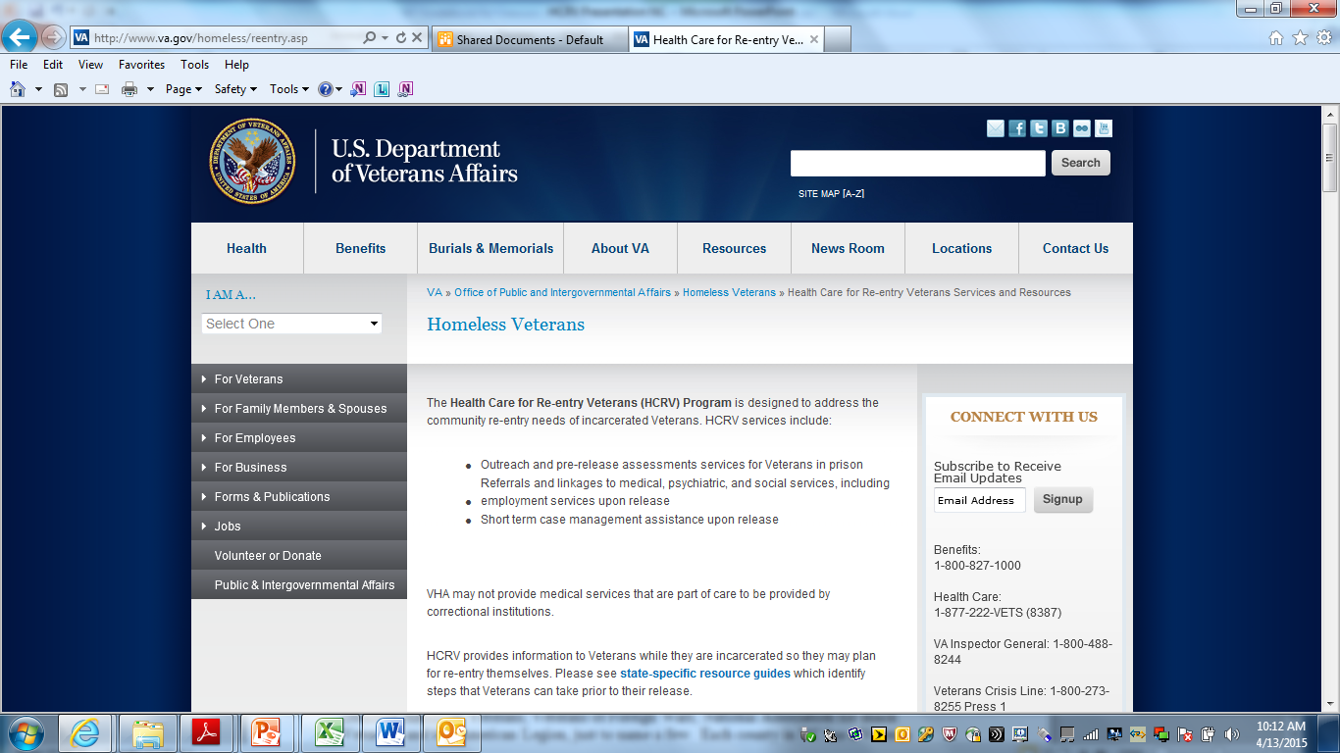
http://www.va.gov/homeless/reentry.asp

Slide 21
Health Care for Reentry Veterans Specialist
Lucas Vrbsky, GED, MSW
W.G. Bill Hefner VA Medical Center
1601 Brenner Ave (122)
Salisbury, NC 28144
800.469.8262 x 5521 (office)
704.267.9565 (mobile)
Lucas.vrbsky@va.gov

Slide 22
Supportive Services for Veteran Families (SSVF) http://www.va.gov/homeless/ssvf.asp
Through the Supportive Services for Veteran Families Program, VA aims to improve very low-income Veteran families' housing stability by providing supportive services in, or transitioning to, permanent housing. VA funds community-based organizations to provide eligible Veteran families with outreach, case management and assistance in obtaining VA and other benefits. Grantees may also provide time-limited payments to third parties (e.g., landlords, utility companies, moving companies and licensed child care providers) if these payments help Veterans' families stay in or acquire permanent housing on a sustainable basis.

Slide 23
Organization | Agency Intake # | Counties Served
United Way of Forsyth County, Inc. | (336)788-4965 | Forsyth, Guilford, Surry, Stokes, Yadkin, Davie, Davidson
Passage Home Inc. | (919) 834-0666 Ext 236 | Wake County
Asheville Buncombe Community Christian Ministry | (828) 259-5314 | Ashe, Avery, Buncombe, Burke, Caldwell, Catawba, Cherokee, Clay, Cleveland, Gaston, Graham, Haywood, Henderson, Jackson, Macon, Lincoln, McDowell, Madison, Mecklenburg, Mitchell, Polk, Rutherford, Swain, Transylvania, Watauga, Yancey
Family Endeavors, Inc. | (910) 672-6166 | Anson, Beaufort, Bladen, Brunswick, Cabarrus, Carteret, Catawba, Chatham, Cleveland, Columbus, Craven, Cumberland, Davie, Davidson, Duplin, Gaston, Greene, Harnett, Hoke, Iredell, Johnston, Jones, Lee, Lenoir, Lincoln, Mecklenburg, Montgomery, Moore, New Hanover, Pamlico, Pender, Pitt, Onslow, Randolph, Richmond, Robeson, Rowan, Sampson, Scotland, Stanly, Union, Wayne, Wilson
Community Link Programs of Travelers Aid Society of Central Carolinas, Inc. | (704) 943-9490 | North Carolina: Mecklenburg, Cabarrus, Catawba, Gaston, Lincoln, Rowan, Davidson, Union, Stanly, Iredell. South Carolina: Lancaster, Chester, Chesterfield and York.
Volunteers of America of The Carolinas, Inc. | (919) 530-1100 | Alamance, Bertie, Caswell, Chatham, Durham, Edgecombe, Franklin, Granville, Halifax, Harnett, Hertford, Johnston, Lee, Martin, Nash, Northampton, Orange, Person, Pitt, Randolph, Rockingham, Vance, Wake, Warren, Wayne, Wilson, Washington
Homeward Bound of Western North Carolina | (828) 258-1695 Ext 108 | Buncombe
The Alston Wilkes Society (AWS, Alston Wilkes Veterans Home) | (704) 372-3404 (803) 799-2490 Ext 315 | Mecklenburg (and parts of SC)
Community Action Partnership | (910) 347-0060 | Onslow, Duplin, Pender

Slide 24
Grant and Per Diem Program Transitional Housing
VA Grant and Per Diem Program (GPD) is offered annually (as funding permits) by the Department of Veterans Affairs Health Care for Homeless Veterans (HCHV) Programs to fund community agencies providing services to homeless Veterans. The purpose is to promote the development and provision of supportive housing and/or supportive services with the goal of helping homeless Veterans achieve residential stability, increase their skill levels and/or income, and obtain greater self-determination. GPD programs offer supportive housing (up to 24 months) or service centers. Most GPD programs charge 30% of your income. Following is a list of GPD programs in North Carolina. There are also several contract residential programs that provide transitional housing for up to three months

Slide 25
Name & Location of GPD Program | Phone Number | Comments
Veteran’s Restoration Quarters and Transitional Housing (ABCCM) 1329 Tunnel Rd Asheville, NC 28805 | 828.299.8701 | 24 month program. Converted motel. www.abccm.org/ministries/veterans Men’s Program.
Steadfast House (ABCCM) 30 Cumberland Ave Asheville, NC 28801 | 828.259.5365 | Women’s Program. Women with young children welcome. http://www.abccm.org/ministries/women
First at Blue Ridge (Vets First) PO Box 40 Ridgecrest, NC 28770 | 828.669.0011 | For those in recovery from substance use disorders. www.firstinc.org Men’s program and Women’s Program. Near Asheville
Family Forum (Independence Place) 3501 E Independence Blvd Charlotte, NC 28805 | (704) 817-8049
Faith Farm (Lutheran Family Services) 842 Dallas-Stanley Highway Dallas, NC 28034 | 800.435.7464 | Women’s Program. www.lfscarolinas.org Near Charlotte.
Healing with CAARE 214 Broadway St Durham, NC 27701 | 919.687.0793 | 24 month program. Shared living space, single rooms in several houses. http://caare-inc.org
Maple Court (Volunteers of America) 207 Commons Blvd Durham, NC 27704 | 919.477.0571 | Apartments. 24 month program.
Triangle Residential Options for Substance Abusers (TROSA) 1820 James St Durham, NC 27707 | 919.419.1059 | For those in recovery from substance use disorders (alcohol and other drugs). Must be able to work. 24 month program. www.trosainc.org
Servant Center 1312 Lexington Ave Greensboro, NC 27403 | 336.275.8585 | For those with medical issues and receiving or applying for benefits. Men’s Program. http://www.theservantcenter.org
Caring Services Vet Safety Net 102 Chestnut Drive High Point, NC 27262 | 336.886.5594 | For those in recovery from substance use disorders (alcohol and other drugs). Men’s Program. www.caringservices.org
Arthur Cassell Transitional House 1022 True Lane High Point, NC 27260 | 336.885.2166 | For those in recovery from substance use disorders (alcohol and other drugs). 24 month men’s program. www.odm-hp.org/ch.htm
Healing Place of Wake County 1251 Goode St Raleigh, NC | 919.838.9800 | For those in recovery from substance use disorders (alcohol and other drugs). 24 month program. www.hpowc.org
Veterans Helping Veterans Heal 3614 N Glenn Ave Winston-Salem, NC 27105 | 336.744.1313 | For those in recovery from substance use disorders (alcohol and other drugs). Men’s program. www.vhvh.org
Good Shepherd Ministries 811 Martin St Wilmington, NC 28401 | 910.763.4424 | For those in recovery from substance use disorders. 18 month program. http://www.goodshepherdwilmington.org

Slide 26
877.WAR.VETS
877.927.8387

Slide 27
Questions, Comments, Concerns
What has been left out of this discussion?
How can we work together to best serve Veterans incarcerated who will be returning citizens to our communities?
? ? ? ? ? ? ? ? ? ?

Slide 28
References
Blue-Howells, J. & McGuire, J. (2007). The VA-Corrections Partnership: Expanding Re-enty Services for America’s Incarcerated Veterans. On the Line: A Publication of the American Correctional Association, 30 (3).
Campbell, R. (2003). Dollars and sentences: Legislators’ views on prisons, punishment, and the budget crisis New York, New York: Vera Institute of Justice.
Council of State Governments Justice Center. Justice Reinvestment in NC: Analysis and Policy Framework to Reduce Spending on Corrections and Reinvest in Strategies to Increase Public Safety (New York: Council of State Governments Justice Center. 2011).
Losel, F. (1995). The efficacy of correctional treatment: A review and synthesis of meta-evaluations. In J. McGuire (Ed.), What Works: Reducing Reoffending (New York: John Wiley and sons).
McGuire, J. (2007). DRAFT White Paper: A logic model for VA health care for re-entry veterans VA Homelessness Prevention and Incarcerated Veterans Programs.

